Slide 1
SISC Small Group Initiative
Messaging serology/immunity results related to COVID-19
Project Launch Meeting
May 21, 2020

Slide 2
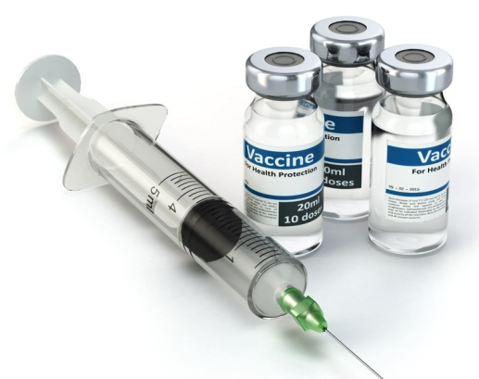
Today
How does it currently work in IIS for other vaccines?

Slide 3
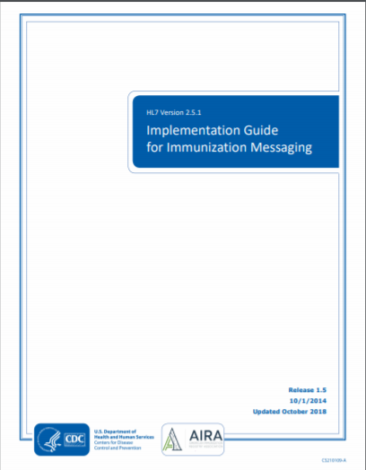
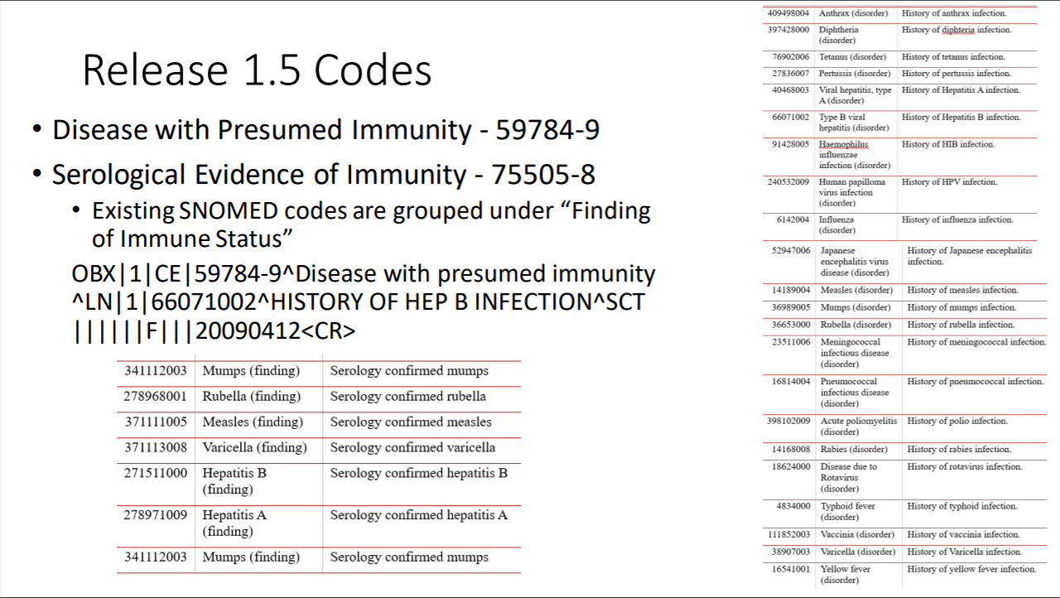
HL7 2.5.1, Release 1.5 Current Functionality
Reference: SISC April 20th Meeting, slides prepared and presented by Craig.
Notes:
How widely is this used?
Depends.
Varicella history of disease and sometimes laboratory evidence of disease continues to be fairly widely used.
Serologies are often done for health care workers.
HepB serology is done in case management scenarios, including perinatal HepB.
Rubella may be done for women that are pregnant or considering becoming pregnant.
Except for Varicella which is likely checking more for disease incidence, these will typically be checking for vaccine effectiveness and/or that the antibodies from the vaccine are still evident.
Typically, when in doubt a vaccine is given.

Slide 4
Example message (for HepB)
MSH|^~\&|MYEHR|DCS|MYIIS||201201130000- 500||VXU^V04^VXU_V04|45646ug|P|2.5.1|||ER|AL|||||Z22^CDCPHINVS
PID|1||432155^^^dcs^MR||Patient^Johnny^New^^^^L|Lastname^Sally^^^^^M |20110411|M||1002-5^Native American^HL70005|123 Any St^^Somewhere^WI^54000^^L||^PRN^PH^^^111^2320112|||||||||2186-5^not Hispanic^CDCREC
ORC|RE||9999^DCS|||||||^Clerk^Myron|
RXA|0|1|20090412|20090412|998^No vaccine administered^CVX|999||||||||||||||NA
OBX|1|CE|59784-9^Disease with presumed immunity^LN|1|66071002^HISTORY OF HEP B INFECTION^SCT||||||F|||20090412
Observation Identifier: 59784-9 (LOINC Code)
Observation Value: 66071002 (SNOMED Code)
Date of Observation: 4/12/2009

Slide 5
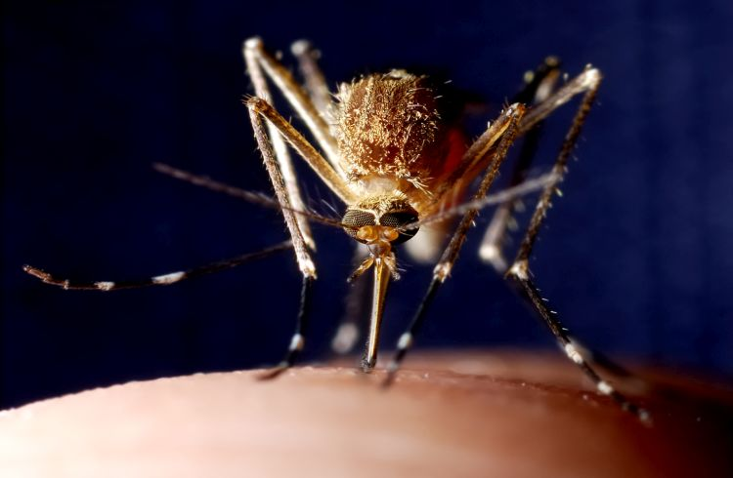
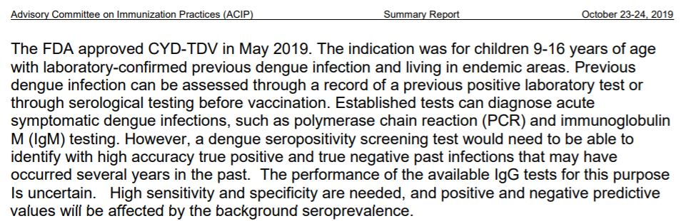
Dengue Fever
DENGVAXIA® approved by the FDA in May 2019
ACIP has discussed at October 2019 and February 2020 meetings
Vote is not scheduled yet
Vaccine would be targeted at:
Areas where dengue fever is endemic (specifically Puerto Rico)
Ages 9 – 16 years
Previous dengue infection (positive IgG result)
Necessary tests are yet approved by the FDA
Notes:
Dengue fever (yet to be recommended by ACIP) is unique in that the serology test will be required for vaccination.

Slide 6
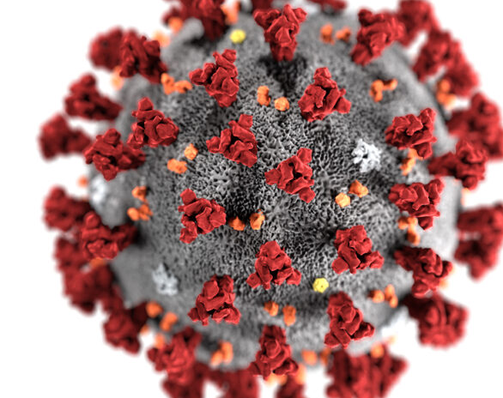
COVID-19
What are the needs?

Slide 7
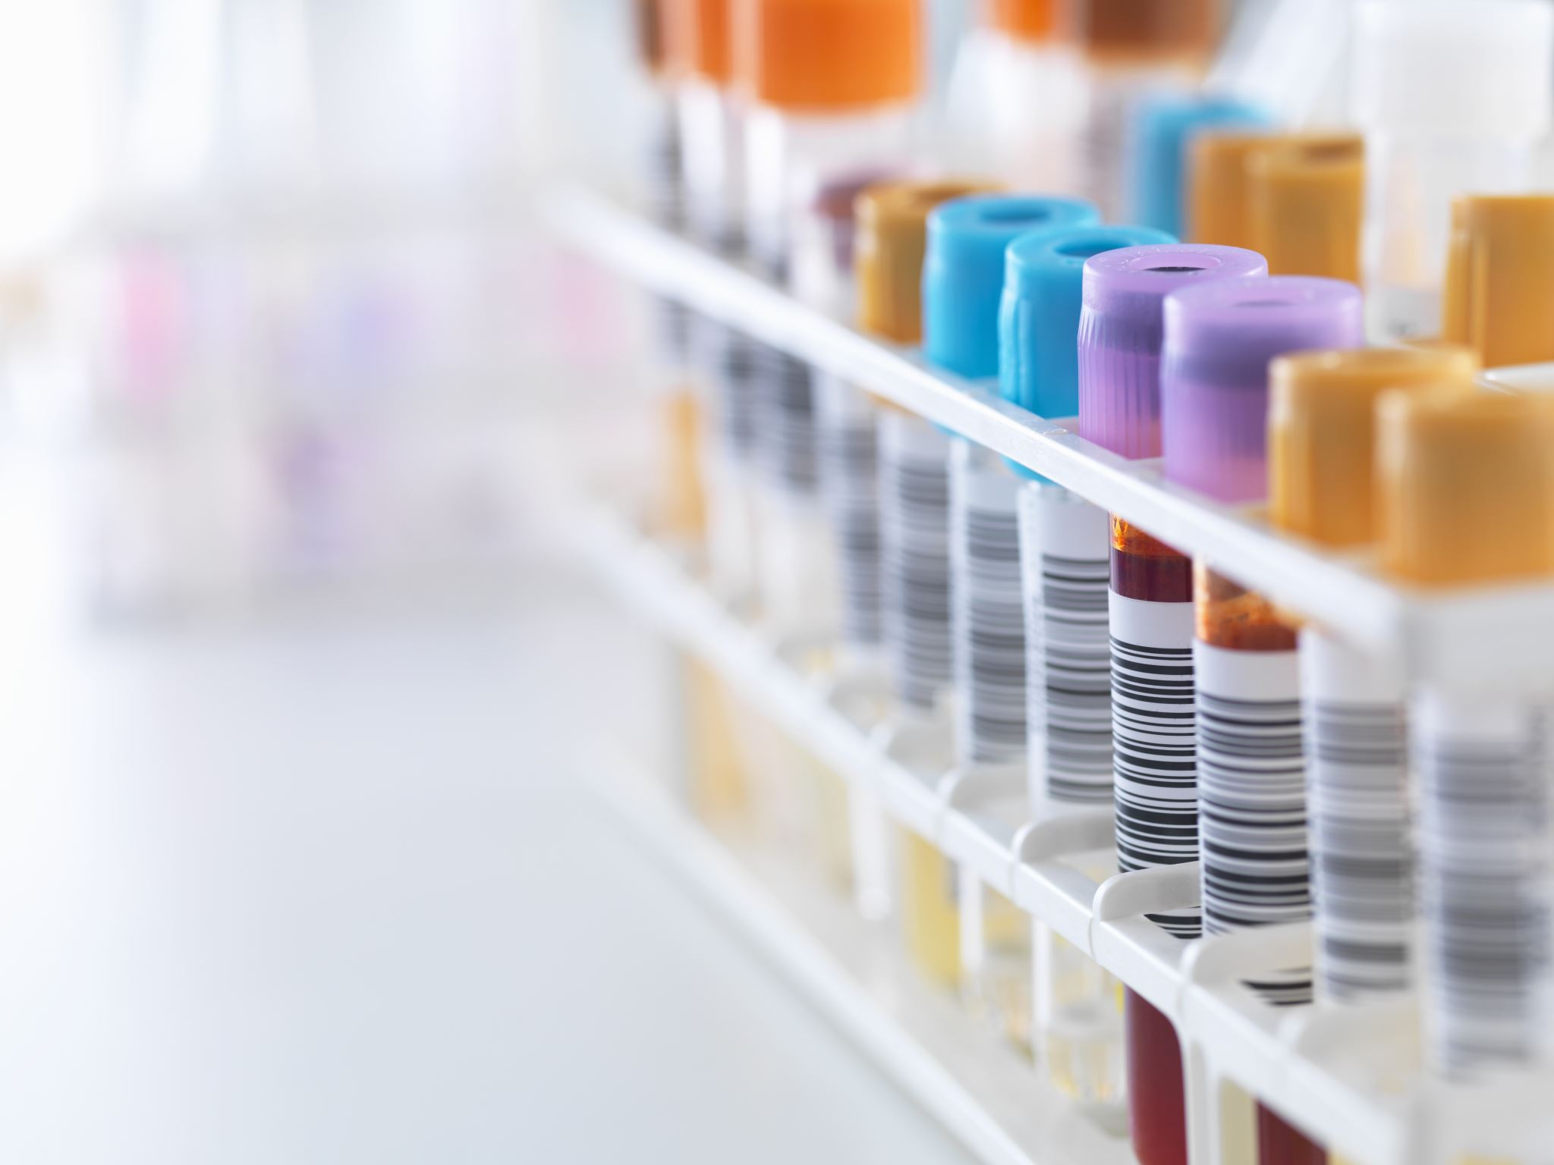
Definitions
Diagnostic Test
PCR (genetic) or protein/antigen (how a flu test works)
Nasal or nasopharyngeal swap
Antibody Test
Shows evidence of disease
Blood test
Notes:
https://www.fda.gov/medical-devices/emergency-situations-medical-devices/emergency-use-authorizations
Two CLIA-waived tests are currently available. Both are diagnostic.
Abbott ID Now
Quidel Sofia
Multiple point-of-care tests are close to FDA approval. In order to meet that testing needs in the U.S., test complexity has to decrease in order to improve test accessibility.
As point-of-care tests reach the market, these tests will be done in settings that are already connected to immunization registries – doctor’s offices, pharmacies, etc.

Slide 8
Definitions
Serology: Diagnostic examination of blood serum
IgM: First response to a microbial infection/antigen invasion. May indicate active disease.
IgG: Most abundant antibody produced (~70-75%). This is the antibody that is mostly responsible for long-term immunity after an infection or vaccination.
CLIA: Stands for Clinical Laboratory Improvement Amendment. A high or medium complexity test will be done at a CLIA lab. A low complexity test (point of care test) may be CLIA-waived.

Slide 9
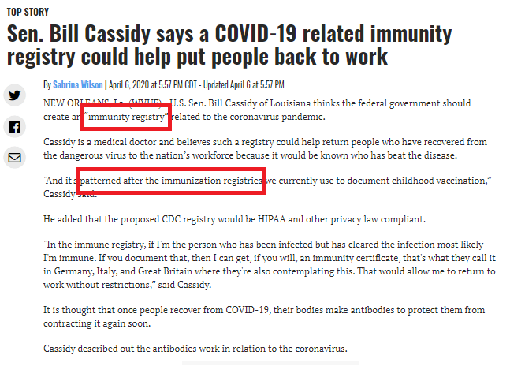
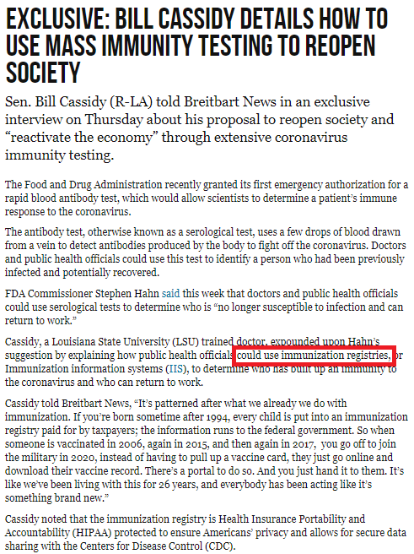
April 6, 2020
April 10, 2020
Sources:
https://www.fox8live.com/2020/04/06/sen-bill-cassidy-says-covid-related-immunity-registry-could-help-put-people-back-work/
https://www.breitbart.com/politics/2020/04/10/bill-cassidy-details-use-mass-immunity-testing-reopen-society/

Slide 10
Why would we want Covid-19 immunity in the IIS?
Immunizations create immunity. So, can or should we think of immunization registries as immunity registries?
IIS already has some capabilities for tracking immunity from laboratory test or incidence of disease (e.g. varicella) and accounting for that in immunization recommendations.
There has been some discussion of checking immunity before immunizing (i.e. manage limited supply; however, the current test accuracy questions has tempered this somewhat).

Slide 11
Current Environment aka “All the unknowns”
All things Covid-19 continue to be a moving target.
Disease surveillance is currently collecting both diagnostic and antibody tests and expects reporting of both.
Details will ultimately be set by ACIP and are not available yet.
Does incidence of disease infer immunity? Maybe not for self-report but would a confirmed diagnostic test be considered.
Will antibodies factor in to immunization recommendations?
Many, many tests with varying accuracy.
Not known if antibodies protect from disease and/or how long protection will last.
Will tests continue to be measured with a qualitative result (e.g. positive/negative) or will there be a need to track a quantitative result (e.g. antibody level)

Slide 12
Limitations to current specification
No way to send negative results or any other result other than “positive”
No differentiation on type of test
Other than date, no other fields about the encounter, e.g. manufacturer, trade name, lot number, type of sample, etc.

Slide 13
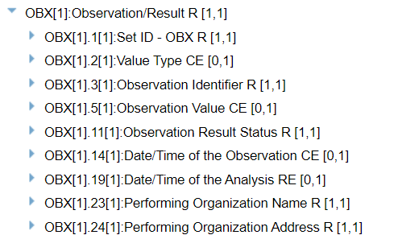
Could and should the IIS accept lab tests with a higher degree of specificity?
For instance, an ORU message sends the test type and the test result in the OBX:
OBX|1|CWE|23826-1^Bordetella pertussis DNA [Presence] in Unspecified specimen by Probe and target amplification method^LN^BPRP^Bordetella pertussis PCR^L^2.40||10828004^Positive (qualifier value)^SCT^BPPOS^Positive^L^20120131^^Positive||||||F|||20120710|||||201207110800||||Queen of the Valley Hospital Clinical Laboratory^L^^^^CLIA&2.16.840.1.113883.4.7&ISO^XX^^^05D0599855|1000 Trancas Street^^Napa^CA^94558^^B
Source: https://hl7v2-elr-testing.nist.gov/mu-elr/, Test Case ELR 7.1.1

Slide 14
Current OBX model
OBX-3: Question
LOINC codes are used to represent the question:
Does this patient have immunity to an antigen?
What test was given?
OBX-5: Answer
SNOMED codes answer the question:
Laboratory evidence of immunity to measles
Positive (any qualitative result)

Slide 15
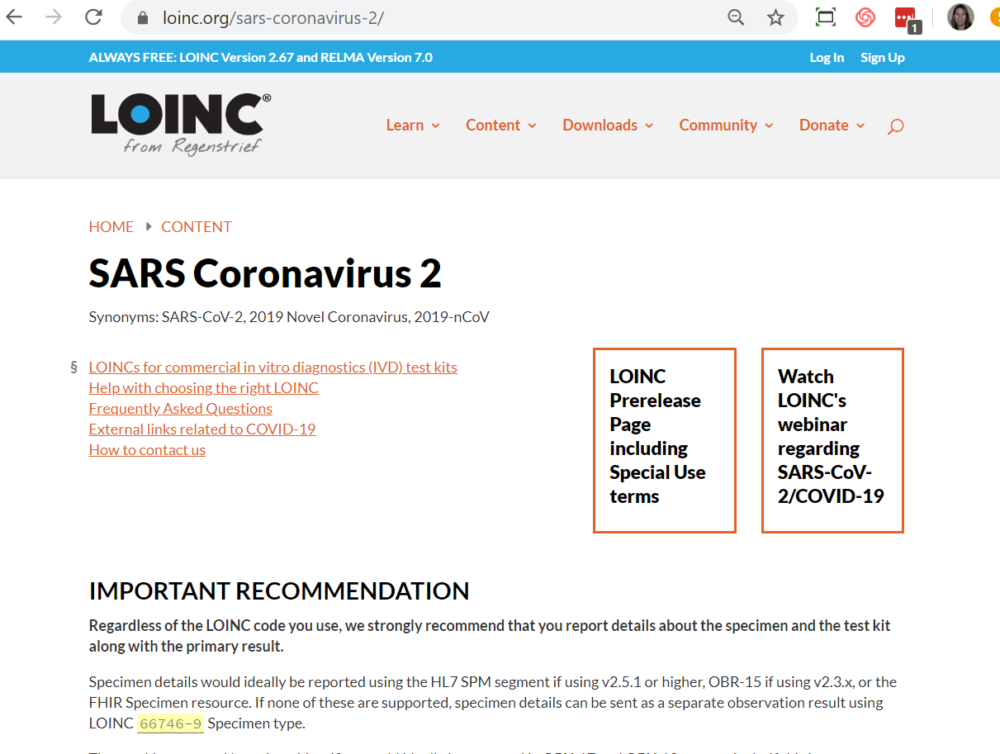
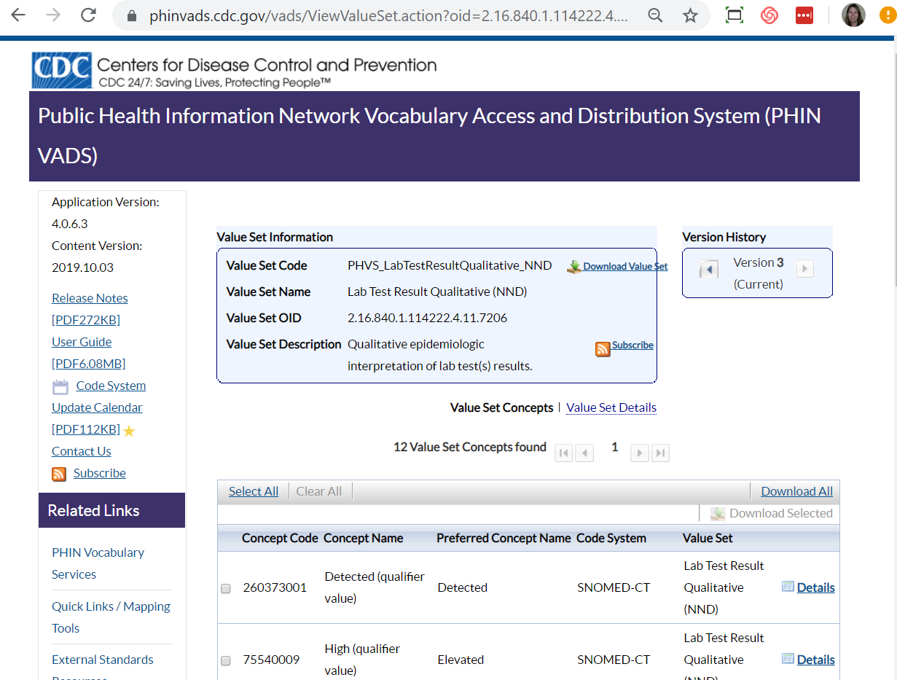
LOINC & SNOMED Codes for Covid-19
LOINC
https://loinc.org/sars-coronavirus-2/
SNOMED
https://phinvads.cdc.gov/vads/ViewValueSet.action?oid=2.16.840.1.114222.4.11.7206

Slide 16
For example, what could this look like for Covid-19?
OBX|1|CWE|94507-1^SARS coronavirus 2 Ab.IgG^LN||10828004^Positive (qualifier value)^SCT||||||F|||20200510|||||202005100800||||Queen of the Valley Hospital Clinical Laboratory^L^^^^CLIA&2.16.840.1.113883.4.7&ISO^XX^^^05D0599855|1000 Trancas Street^^Napa^CA^94558^^B

Slide 17
Scope
Description | In Scope | Notes
Negative tests | Yes | Is this similar to refusals, e.g. a vaccination that didn’t happen. Is a positive test the only thing we would act on? Negative would differentiate from unknown Transient, think about how that would be used. Timing element, to factor into vaccination, there would need to be minimal time between test and vaccination.
Data submission and/or query | Yes | Both
Can the IIS query this from another source? | No - Future consideration | Wide variety of systems that may have the data (HIE, ELR, Disease Surveillance, etc.) Cover this in summary that this may be a significant piece of the puzzle to be worked in the future
Type of test | Maybe? | Available in messages that DS receives (ORU)
Test date | Yes | Currently supported in OBX – part of scope will be clarifying OBX-14 & OBX-19.
Manufacturer, trade name, lot number | No | Not likely available from DS (ORU messages)
Diagnostic tests | Out of scope | Too early to infer history of disease based on diagnostic tests.
Qualitative vs Quantitative | Yes | Address in guidance how these should be handled. Getting data in raw form and then meaning can be determined. Important to accept the values as sent so that IIS has data rather than interpreting.
Antibody tests | Yes

Slide 18
Notes from call (5/26)
Make sure that we aren’t making assumptions that “unknown” is negative. If there is no test, logic should treat that as truly unknown not infer that that is negative.
Rob will get example ORU messages for NIST

Slide 19
Notes from call (5/21)
Should we get the data from disease surveillance systems rather than from providers?
APHL AIMS may be able to help with directing the messaging and/or providing data about what they are seeing.
It doesn’t matter who reported the ELR if we get it from DS

Slide 20
Tasks
Task | Participant
Guidance document Specific technical guidance Proposal only, SISC will review
Test Cases Testable scenarios that verify adherence to guidance
Technical demonstrations Prove workability of guidance Provide reference implementation

Slide 21
Next Steps and Communication
Slack channel
messagingserologyimmunity
GitHub
Supporting materials: Send any supporting materials to Nathan, Kim and Brandy
Scheduled touch base meetings
Tuesday, May 26th – Agenda: 1) finalize scope; 2) define deliverables
Thursday, May 28th
Tuesday, June 2nd
Work day – decide on a time
Wednesday, June 3rd (11am PT/2pm ET) – Thursday, June 4th (11am PT/2pm ET)

